Slide 1

JDL
Returns
DEPARTMENT
04.30.2025
CONFERENCE / EVENT PRESENTATION
PRESENTATOR: Miguel Garcia
BY OSI Staffing

Slide 2

Welcome to the Returns Department
Returns Department
This is JDL’s returns department. Here, we work with AWAY products only.
Job Description: AWAY Returns Department at JDL
We begin by processing any backlog items in the system (items sitting in the warehouse longer than 48hrs).

Slide 3
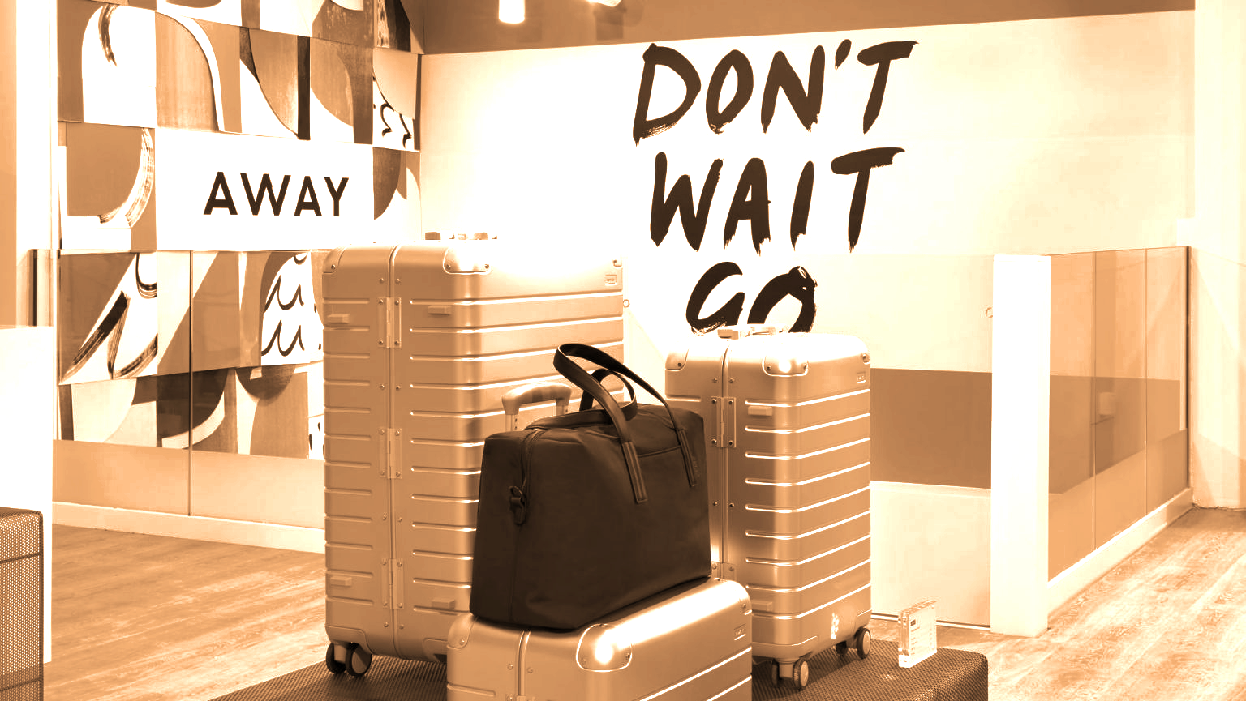
AWAY LUGGAGES
The company focuses on creating high-quality, thoughtfully designed luggage and travel accessories that make traveling easier and more enjoyable.

Slide 4




Additionally, AWAY has collaborated with various designers and celebrities.
AWAY
limited-edition collections, further appeal to a wide range of travelers. The company's mission: inspire and enable more meaningful travel experiences for people around the world.
2015
The Carry-On
100 Day Free Trial
Environment
AWAY is a modern travel and lifestyle brand that was founded in 2015 by Jen Rubio and Steph Korey. The company focuses on creating high-quality, thoughtfully designed luggage and travel accessories that make traveling easier and more enjoyable.
AWAY is best known for their durable and stylish suitcases, such as the Carry-On, which comes with a built-in battery to charge your devices on the go.
Their products are sold both online and in their retail stores, where customers can experience the brand firsthand. AWAY has a strong commitment to customer satisfaction, offering a 100-day trial period and lifetime warranty on their luggage.
They also emphasize sustainability by using recycled materials and supporting various environmental initiatives.

Slide 5

Job
Returns Department
AWAY Returns Department at JDL
Here in the JDL Returns Department, we handle a variety of essential tasks to ensure the efficient processing of returned items.
Description

Slide 6

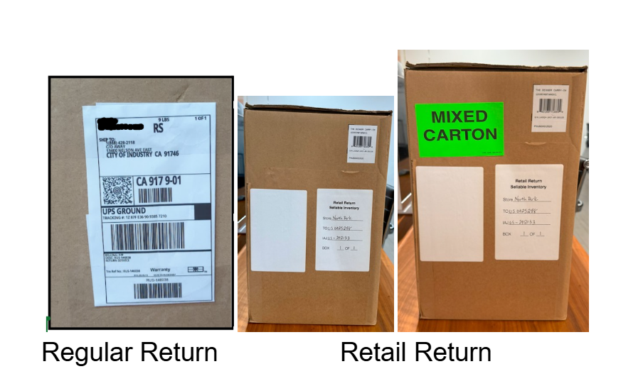



Each Day
Start:
UPS/FEDEX truck
Metal Basket
Team must unload a “returns” truck and account for all returned items. Once the returns are verified, the team sorts, cleans, re-boxes, re-labels, and grades the items before putting them away. Our goal is to maintain a seamless returns process and uphold the highest standards of quality and organization.
We begin by processing any backlog items in the system (items sitting in the warehouse longer than 48hrs).
two or more people will help unload it. Two different products arrive, AWAY and non-away. We make sure to separate them during the unloading process to avoid mix ups Once everything is unloaded, all tracking numbers will be recorded, obtaining the total number of products that arrived, separating them into three main categories: RS, Non-RS, and Retail
Once all tracking numbers are recorded, they will be placed in a metal basket to then be transported to the returns department. Once they arrive, they will be removed from the baskets and placed on a pallet to be wrapped and counted.

Slide 7
Returns Dept
RS
Non-RS
RETAIL

Slide 8
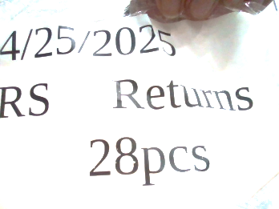
Returns Department
Labeling
A label will be placed on both sides where the pallet jack enters, and this label will include the date the items arrived at the warehouse, the number of products on the pallet,and a legend stating that they are indeed RETURNS. Then the sorting, cleaning, re-boxing, re-labeling, and grading of the products begin.
04.30.2025
CONFERENCE / EVENT PRESENTATION

Slide 9
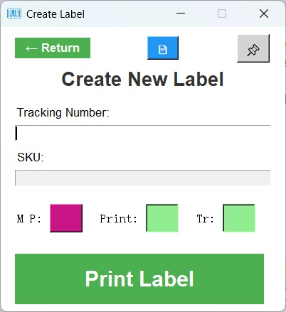
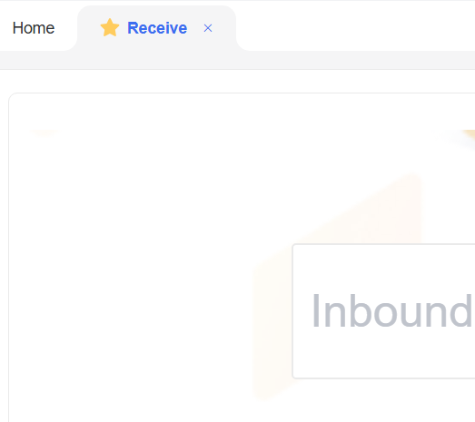
Scan
Scan Tracking#🔖 SKU 📦 & iWMS
Reverse Inbound Creation
Inspect, Grade and Sort
Label Maker V3
Scan the Tracking Number Once.
Use Create Label, and paste it in to iWMS Reverse Inbound Creation, and Receive

Slide 10
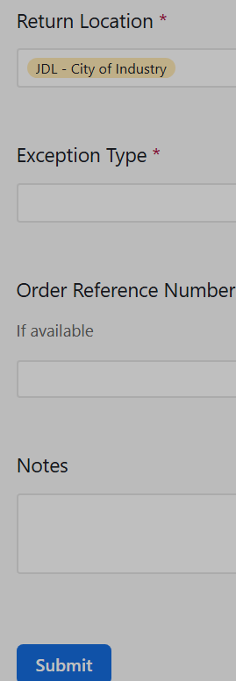
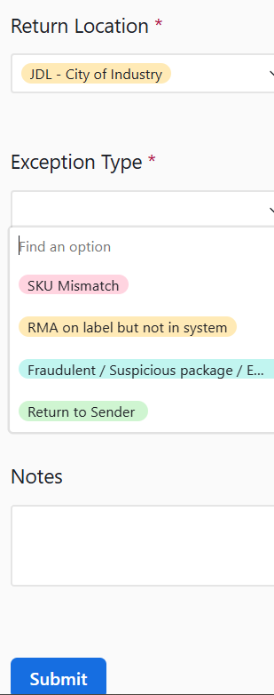
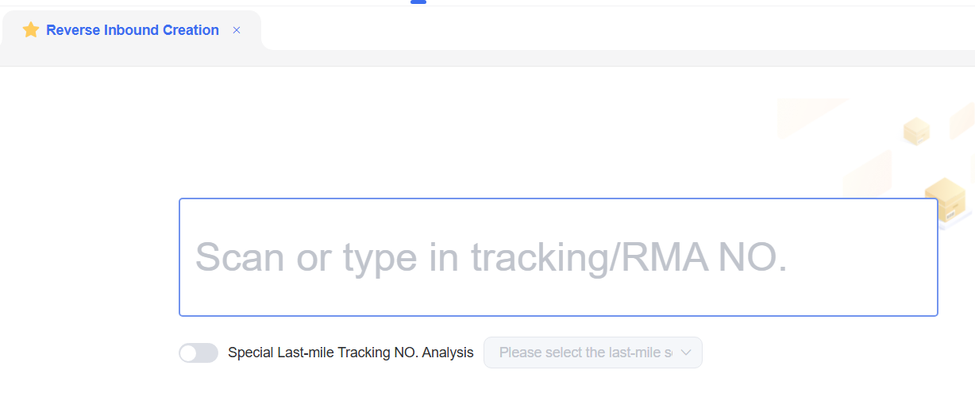
Search for, or Create Label and Re-box. Receive, Item Info, Container Card, Put Away. Or
Exceptions Received Form, RMA on label but not in system. Sort to Put Away
When Return to Sender Always type the SKU.
Notes:

Slide 11
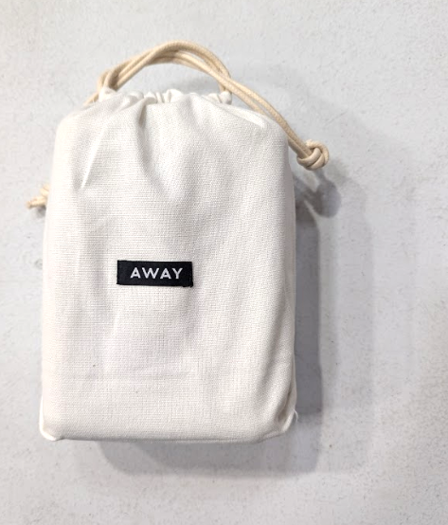
Grading
80%
100%
50%
20
Returns Department
JDL Returns AWAY Grading System
Brand New: Usual standard – no defects.
Like New: Minor flaws, like a tiny scuff.
Very Good: More visible scuffs, but still works perfectly.
Not Sellable: Has functional issues.
Brand New
Not Sellable
Very Good Like New
Recycle Pallets

Slide 12
STEP PLAN
Returns Department
Scan Tracking Number
Inspect, Grade and Sort
Search for, or Create Label and Re-box.
Receive, Item Info,
Container Card, Put Away.
9:00AM PT
12:00PM ET
9:15AM PT
12:15PM ET
10:00AM PT
1:00PM ET
10:30AM PT
1:30PM ET
10:45AM PT
1:45PM ET
11:00AM PT
2:00PM ET
12:00PM PT
3:00PM ET
2:00PM PT
5:00PM ET

Slide 13

Returns Department
Disposal Process
Q01061 Transfer
Palletize
Write it Q01061 Sheet
Pallet Assigned Letter
Weight
SKU Name/Count

Slide 14
COMPANY NAME

Slide 15
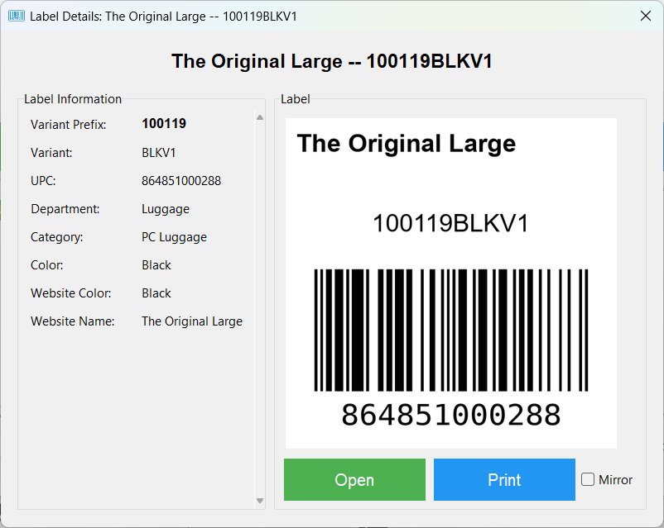
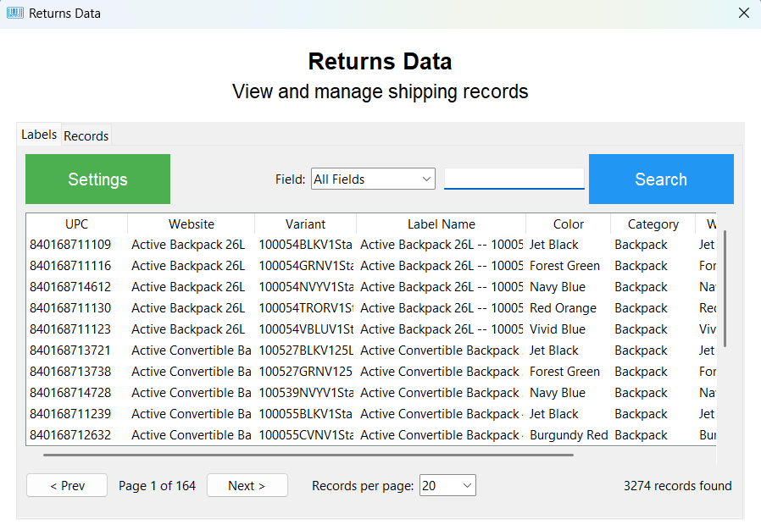
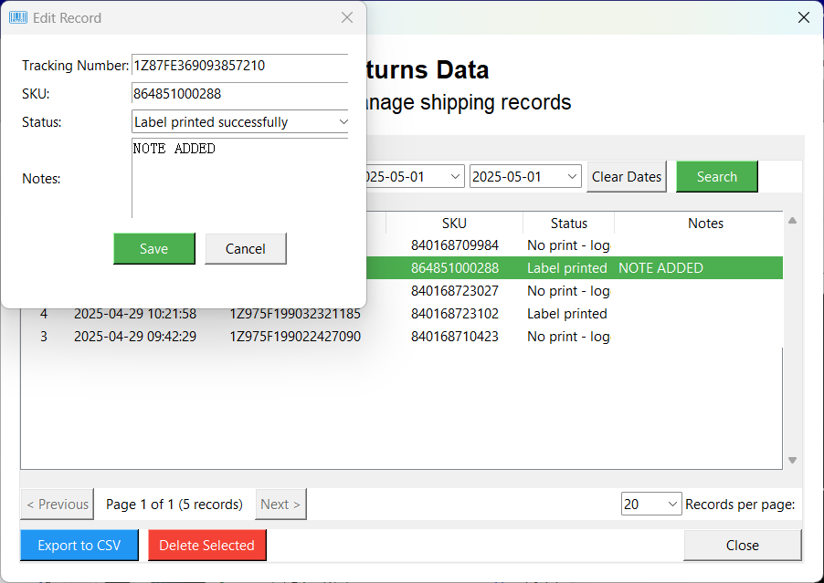
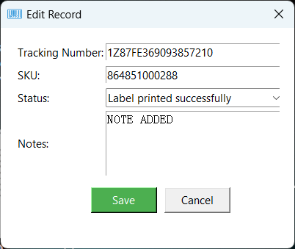
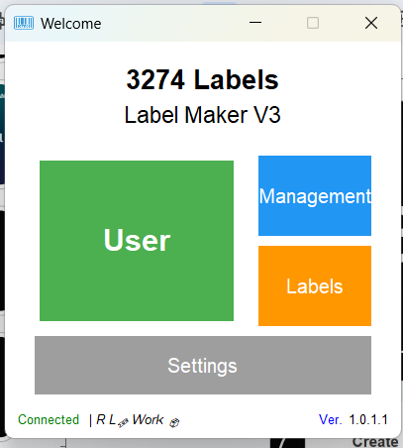
Search
Search Tracking#🔖 SKU 📦 & more.
Labels
Label Maker V3
Scan the Tracking Number Once.
Use Create Label, and paste it in to iWMS Reverse Inbound Creation, and Receive

Slide 16
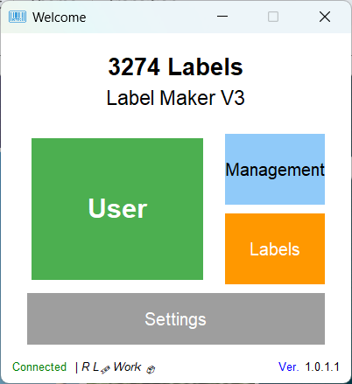
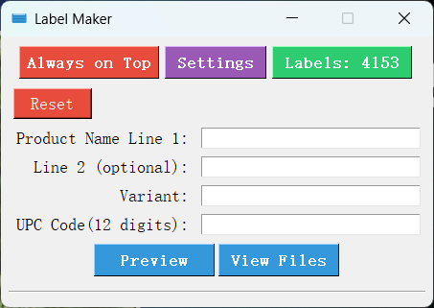
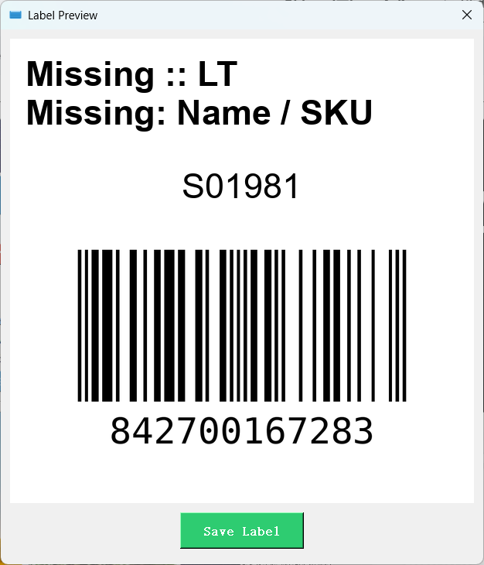
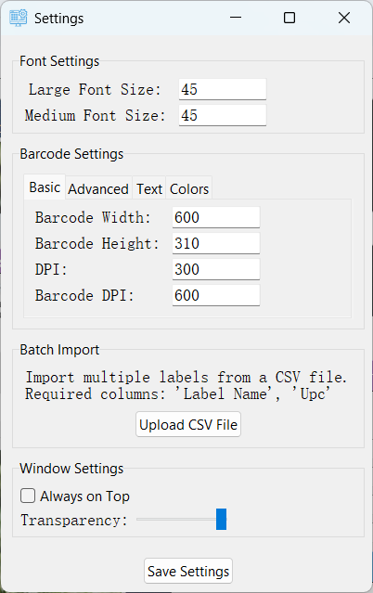
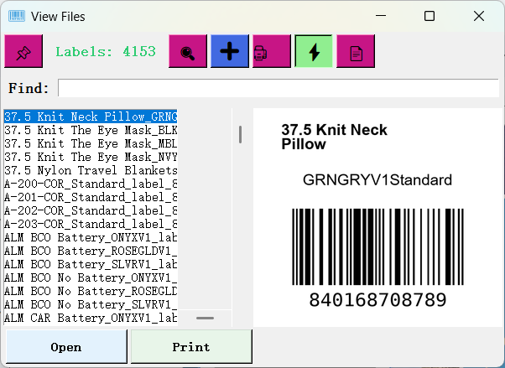
COMPANY NAME
Make A Label

Slide 17
THANK YOU
MM.DD.YY
CONFERENCE / EVENT PRESENTATION
FULL NAME
WEBSITE / PHONE NUMBER

